Slide 1
Python Basics

Slide 2
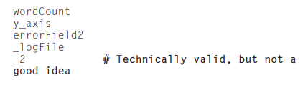

Identifiers & Operators
Variable names and other identifiers in Python are similar to those in many other languages: they start with a letter (A–Z or a–z) or an underscore (“_”) and are followed by any number of letters, numbers, and underscores.
they are case-sensitive

Slide 3
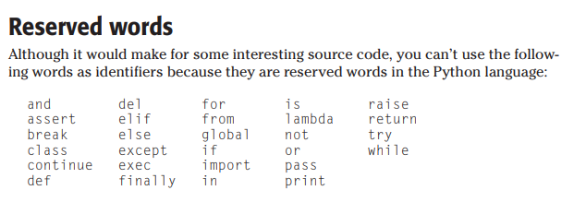
a single underscore character (_) is a special identifier that holds the result of the last expression evaluated.

Slide 4
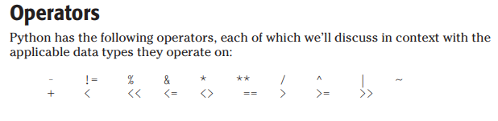

Slide 5
Numeric Types
Python has four built-in numeric data types:
  integers
  long integers
  floating point numbers
  imaginary numbers.
Integers are whole numbers in the range of -2147483648 to 2147483647 (that is, they are signed, 32-bit numbers).
the sys module has a maxint member that holds the maximum positive value of an integer variable

Slide 6
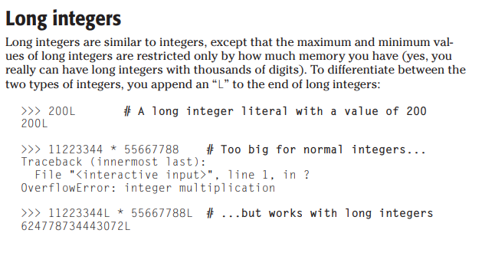

Slide 7
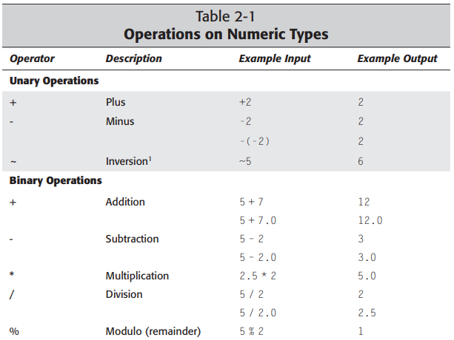

Slide 8
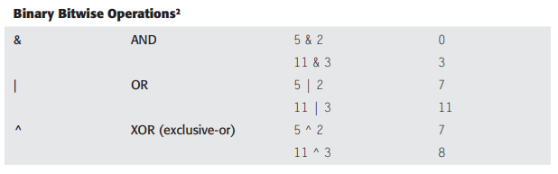
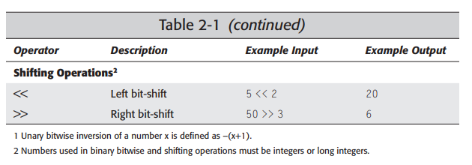

Slide 9
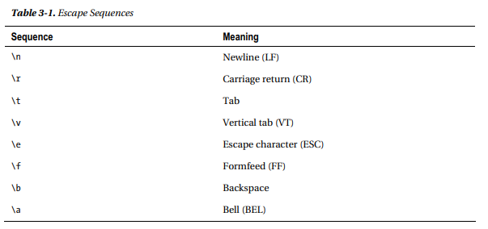
Using Escape Sequence

Slide 10


Slide 11
The End

